Slide 1
End-Point PCR Hackathon Introduction

Slide 2
Congratulations on your promotion!
You are the new general manager of a critical business in the Bioscience Division (BID). The business unit sells products to enable customers to perform polymerase chain reaction (PCR) based applications.
The products in your portfolio includes THERMAL CYCLERS, instruments to conduct the PCR reactions and the PCR PLASTICS, consumables that contain the reaction mixes and then placed into the Thermal Cyclers
You are coming on at a critical time for the business. The PCR Plastics market doubled overnight due to the COVID pandemic as the PCR plastics are used for the COVID diagnostics workflow. BID invested heavily into expand capacity of PCR plastics and is looking to you for guidance on the business
Your goal is to understand your business, diagnose any areas of concern, and then drive a winning strategy to position your business for long term success. Since you just took the DSIL sponsored Machine Learning course, you figured leveraging Machine Learning could be one way to help you reach your goal!
Let’s get started!

Slide 3
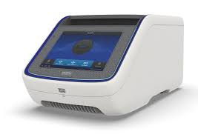
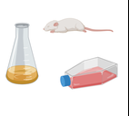
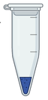
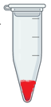
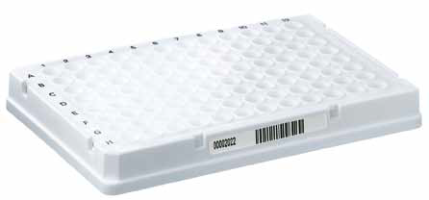
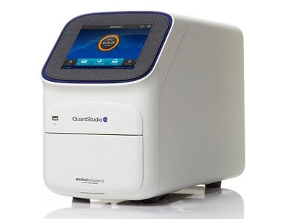
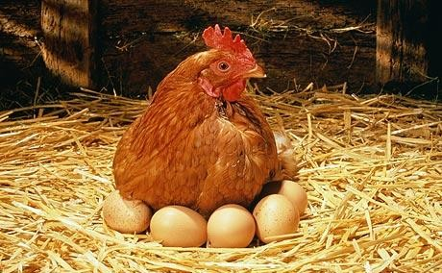
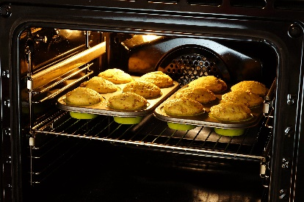
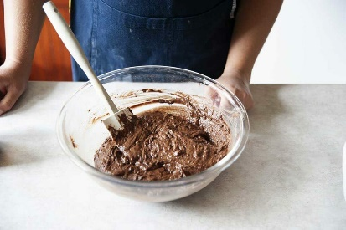
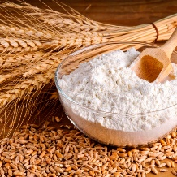
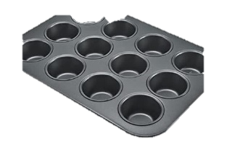
What is PCR?
Extract nucleic acid
Modify nucleic acid
Assemble PCR/qPCR
Perform PCR/qPCR
Visualize & purify PCR product
ePCR enzymes
dNTPs
Thermal Cycler
Primers/Oligos
Electrophoresis
Purification
Use PCR product for Application
Reverse transcription: RNA -> cDNA
qPCR
Genotyping
NGS, Sanger sequencing
Cloning
Ligation of adapters for NGS
Plastics
Extract the ingredients
Make the mixture
Assemble the mixture
Bake
Use the cake for other purposes
Mix the eggs, flour, butter
Blueberries
Cream
Make a multi layer cake
Make cake ice cream
Crumbled cake pie crusts pie
Oven
Muffin Pan
Introduction: https://www.youtube.com/watch?v=Nl6eLez3CNI

Slide 4
PCR Workflow Overview
Extract nucleic acid
Modify nucleic acid
Assemble PCR/qPCR
Perform PCR/qPCR
Visualize & purify PCR product
ePCR enzymes
dNTPs
Thermal Cycler
Primers/Oligos
Electrophoresis
Purification
Use PCR product for Application
Reverse transcription: RNA -> cDNA
qPCR
Genotyping
NGS, Sanger sequencing
Cloning
Ligation of adapters for NGS
Plastics
Table above shows the workflow and the products used at each stage of the workflow. RED products are in your portfolio. GREEN products are additional data sets to support your analysis
Workflow Name | DSR Product Grouping | DSR Product Sub Grouping
Plastics | TC & Plastics | -PCR Plastics -Thermo Scientific Plastics
Thermal Cycler | TC & Plastics | PCR Instruments
Reverse Transcription | EPCR Reagents | -Reverse Transcription
ePCR enzymes and dNTPs | EPCR Reagents | -ePCR reagents -PCR enzymes -Thermo Scientific Reagents
Primers/Oligos | EPCR Reagents | Oligos
qPCR | QPCR Instruments/ QPCR Instruments-COVID | ALL

Slide 5
Key Questions
How’s the data:
investigate if there are gaps in the data and then cleanup data to prep for Machine Learning and analysis
Forecasting:
Build a model to improve forecast (quantity or sales) by SKUs in DSPR Product Sub Grouping PCR Plastics, Thermo Scientific Plastics, and PCR Instruments
Use training set of historical information: 2017-2020 Full Year, and 2021 H1.
Forecast for 2021 Quarter 3 and beyong
Fueling growth
With decrease in testing, you see your PCR plastics business in decline. You are looking for ways to drive sales growth post COVID
Build a model to find opportunities to drive attachment of plastics or instruments in customer segments or by accounts (SGN Name). Attachment means if customer buys this, they also can be predicted to buy that
Identifying Customers
Customer segment is currently labeled by column Customer Segment Group. We wish to zoom in deeper into the customer segment. If given a list of detailed customer segment, create a model to predict the detailed customer segment based on historical transaction data?
Use the customer segment training set data. Identify segment by SEGMENT_1, covid-base, application
Identifying opportunities
The products in your portfolio are the raw materials of many of the end products of innovations of other life sciences companies. For example, Mesa Biotech (acquired by Thermo Fisher) was an early customer of many of the products. Given a list of companies who have come up with successful products, can you predict which customer will be the next to launch a product? In addition, can you predict which products will experience commercial success? Parallel example is companies selling on Amazon and then Amazon launching Amazon branded products to compete. See successful customer data set
Create your own opportunities and insights—generate your own questions that helps drive business

Slide 6
How is Forecasting done now?
Goal: ensure product supply meets customer demand to meet customer expectations
How is information used: product management works with sales to predict demand, reviews historical information, sends estimates to demand planner, sends to manufacturing planner, send to the plant to produce—includes for new demand and safety stock
How this is done: based on historical information, talking to sales, very difficult during black swan events like COVID
Will review examples of current process: Plastics and Thermal Cyclers

Slide 7
Fuel Growth: Drive Attachment
Customer 1
Eggs
Muffin Pan
Oven
Customer 2
Eggs
Muffin Pan
Oven
Customer 3
Eggs
Muffin Pan
Oven
Why is customer 2 spending less on eggs—getting eggs from another company or application requires fewer number of eggs?
Why is customer 3 spending less on oven and pan—getting oven & pan from another company or application requires fewer number of oven and pan?
Is there an ideal/target ratio (by quantity or sales) of products for the customer. Ideal ration for each segment of customers (healthcare, academic, diagnostics)

Slide 8









Who are the customers: Customer Segments
Characteristics | Academic | Molecular Diagnostics (MDX) | Pharma/Biotech
Goals | Achieve consistent and reliable results Minimize cost | Achieve consistent and reliable results to succeed in regulated environment Reduce COGs ($/reaction) | Achieve consistent and reliable results Reduce COGs ($/reaction)
What customers care about | Cost Ease of use Reliability Performance Speed | Reliability: regular qualification of instrument Scalability (automation) Service Performance Ease of use | Reliability Scalability Service Performance Ease of use
How customers came to use current instruments/products | Already in the lab Previous experience Brand loyalty | Validated instrument/plastics | Already in the lab Previous experience Lower $/reaction
What would motivate them to buy | Recommended by workflow Lower cost Availability of products: COVID demand | Data/support data to get test approved quickly or win wider adoption Cost savings: bundling with plastics and reagents Availability of products: COVID demand | Recommended by workflow Cost savings: bundling with plastics and reagents Availability of products: COVID demand
Top Customers
Notes:
Add in the top company logos

Slide 9
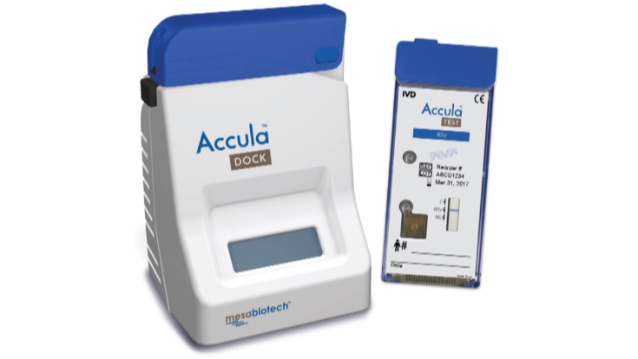
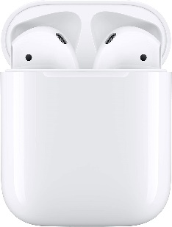
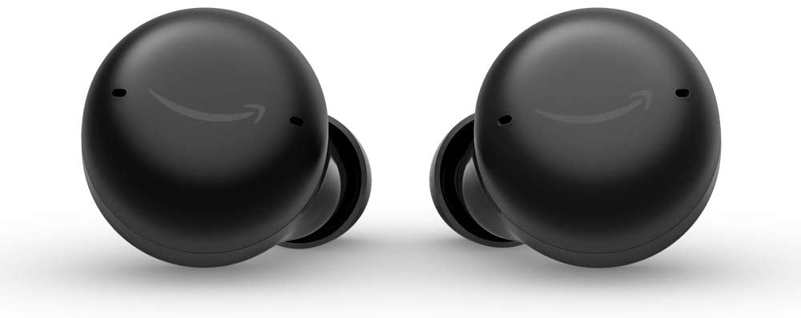
Identifying Opportunities
Mesa Biotech was a Molecular Biology Customer. In 2021, Thermo Fisher bought Mesa for $500M.
Given list of customers with successful products, any purchase behavior to predict that the product will be successful?
Based on purchase behavior, prediction of what the customer may be developing?
Other insights from data to drive sales growth!

Slide 10
Dataset
Sales transaction data from 2017 – 2020 full year, 2021 H1 (Quarter 1 and 2)
Covers the following DSR Product Grouping: think of the pans, ovens, eggs, butter, flour
TC & Plastics
EPCR Reagents
QPCR Instruments/COVID (GSD)
Mol Tools
Molecular Diagnostics
Accessory files
Consult the “data dictionary_d1_20210823” for explanation of column labels
Additional data key
Training set of data for customer segments and successful companies
Communication
Hackaton chat to have your questions answered
Office hours with KOLs

Slide 11
Hackathon Details
Duration: 3 weeks
Team: 2-4 people
Teams will present to panel of judges from Molecular Biology leadership team
Business: Business Leaders
Technical: Chris Bishop
Start: September 20th
BIG Prize
First place team: $2,000
Second place team: $1,000

Slide 12
Appendix

Slide 13
Dictionary of Terms
Term | Explanation | Further resources
PCR | Polymerase Chain Reaction (PCR). Molecular biology technique used by scientists to make a lot of genetic material (RNA or DNA) | https://en.wikipedia.org/wiki/Polymerase_chain_reaction https://www.youtube.com/watch?v=uKeMiAZ8Zu4

